Slide 1

Agricultural
Supply Chain
Global South - East African - Ethiopia
Notes:
AS Global South is a wide context. We choose East African as the focus, with Ethiopia as the main sample.

Slide 2
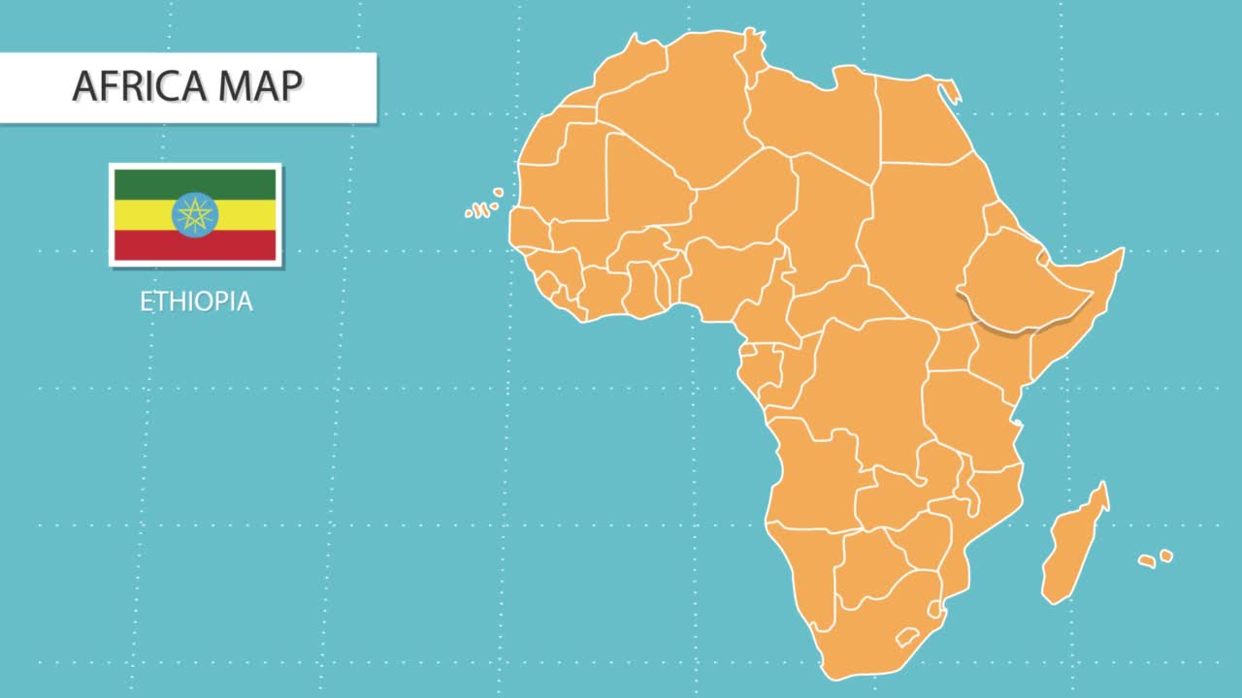
Agriculture in Ethiopia
GDP
40%
Employement
67%
Export
80%
Notes:
We plan to fight malnutrition by raising food affordability of common people and the food stock on market.
Therefore, we analyzed the current agriculture products market on Ethiopia...
Ethiopia agriculture employs nearly 70% of its population and make up 80% of their export.
But, why it only contribute to 40% of the GDP??
There should be some issue here.

Slide 3

International Agriculture Investment Dataspace Service
(BS-IAI)
Supply Chain
Agricultural
Crop Yield Prediction Service
(BS-CYP)
Fair Price Advisor Service
(BS-FPA)
Goal of
Business Services
East African has supply chains that often resemble a complex web with weak links scattered throughout. Recognizing these challenges, we have developed a suite of innovative business services aimed at fortifying these fragile links and ushering in a new era of agricultural sustainability and prosperity.
The agricultural industry is a series of activities from the production of raw materials, processing, and marketing and distribution as a series of activities in one system.
Notes:
- Fix weak links feasible, resource-people-practice
- crop yield : prevent fail harvest
- International Agriculture Investment Dataspace Service : giving fund for farmer to access new tech. raising trust for companies
- fair price : prevent middle man, affordable food in city, better farmer income, no food waste due to unsold food
------------------------
So, from our investigations.
There is some [weak links] in the current supply chain process.
So, we choose to [address this weak link] than make a new whole business process.
As there have been current people, resource and practices involve. So, [fixing and reuse current practice has higher feasibility to be success.]
1. FAILED HARVEST.
Prediction service to solve the issue of failed harvest. By early detection, we hope that the signs of failed harvest can be detected and fixed early on.
[Decreasing failed harvest, will increase the food stocks.]
2. LACK OF FUNDING
However, many of the [farmers in the Ethiopia dont have enough to use the technologies.] Meanwhile, many foreign investors has invested to countries around, but it is harder to expand their market because there are no standard law and audit to check the land and farmer. So, by this standardized dataspace, we will [raise the trust of companies for investing] by share data of Ethiopia, and fellow countries which are checked for the legal [issues].
3. Fair Price Advisor :
After the production, we move to distribution. The issue is there are some middleman that skyrocket raise the price on the market, but pays the farmer a penny..
So, this is issue with many people cant afford the food in market, which turn into food waste. And Farmer can get enough income.
So, by open standardize price, we try to clear this issue.

Slide 4

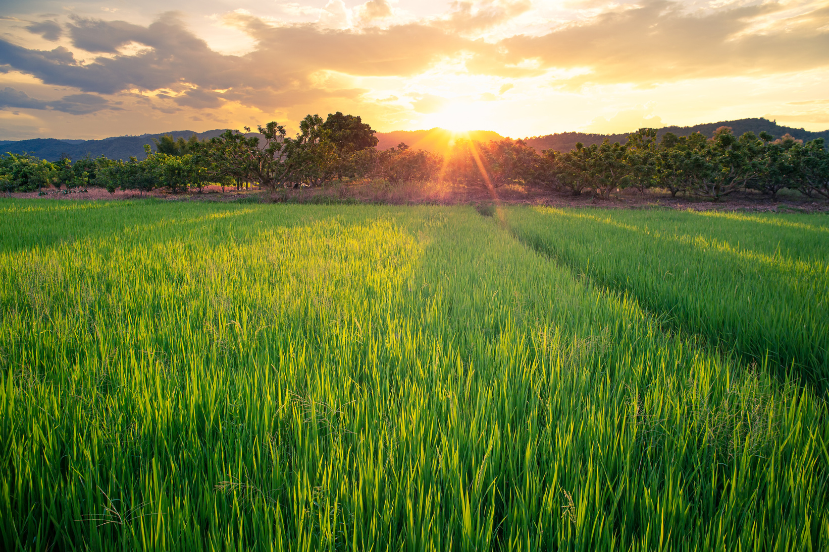
Functional
Requirements
FR1-CropAnalysts
FR2-PriceInformation
Providing In-depth agricultural analytical insights and recommendation, by tailoring forecast and customise information.
Providing fair current and future market price specific to the crop species and plantation area
FR3-Investment
Dataspace
FR4-Recipe Recommendation Service
Establishing a standardised and secure dataspace that complies with local legislation while also enabling overseas investors to confidently analyse and consider their funding options
Raising affordability and reducing food waste by empowering people by promoting ways to process locally produced food stocks.
Decreasing hunger by supporting whole agriculture supply chain, consist of supporting agriculture industry, raising crop yield, and decreasing food waste
Notes:
Therefore, as explanations before..
We have 4 functional requirements. 1 for each of BS:
1. FR1-CropAnalysts : tailoring forecast and customise information to give farmer an exact quality and warning of their field
2. FR2-PriceInformation
Providing fair current and future market price specific to the crop species and plantation area
3. FR3-Investment
Dataspace
Establishing a standardised and secure dataspace that complies with local legislation while also enabling overseas investors to confidently analyse and consider their funding options
4. FR4-Recipe Recommendation
Publishing recipes which ingredients sourced locally.

Slide 5
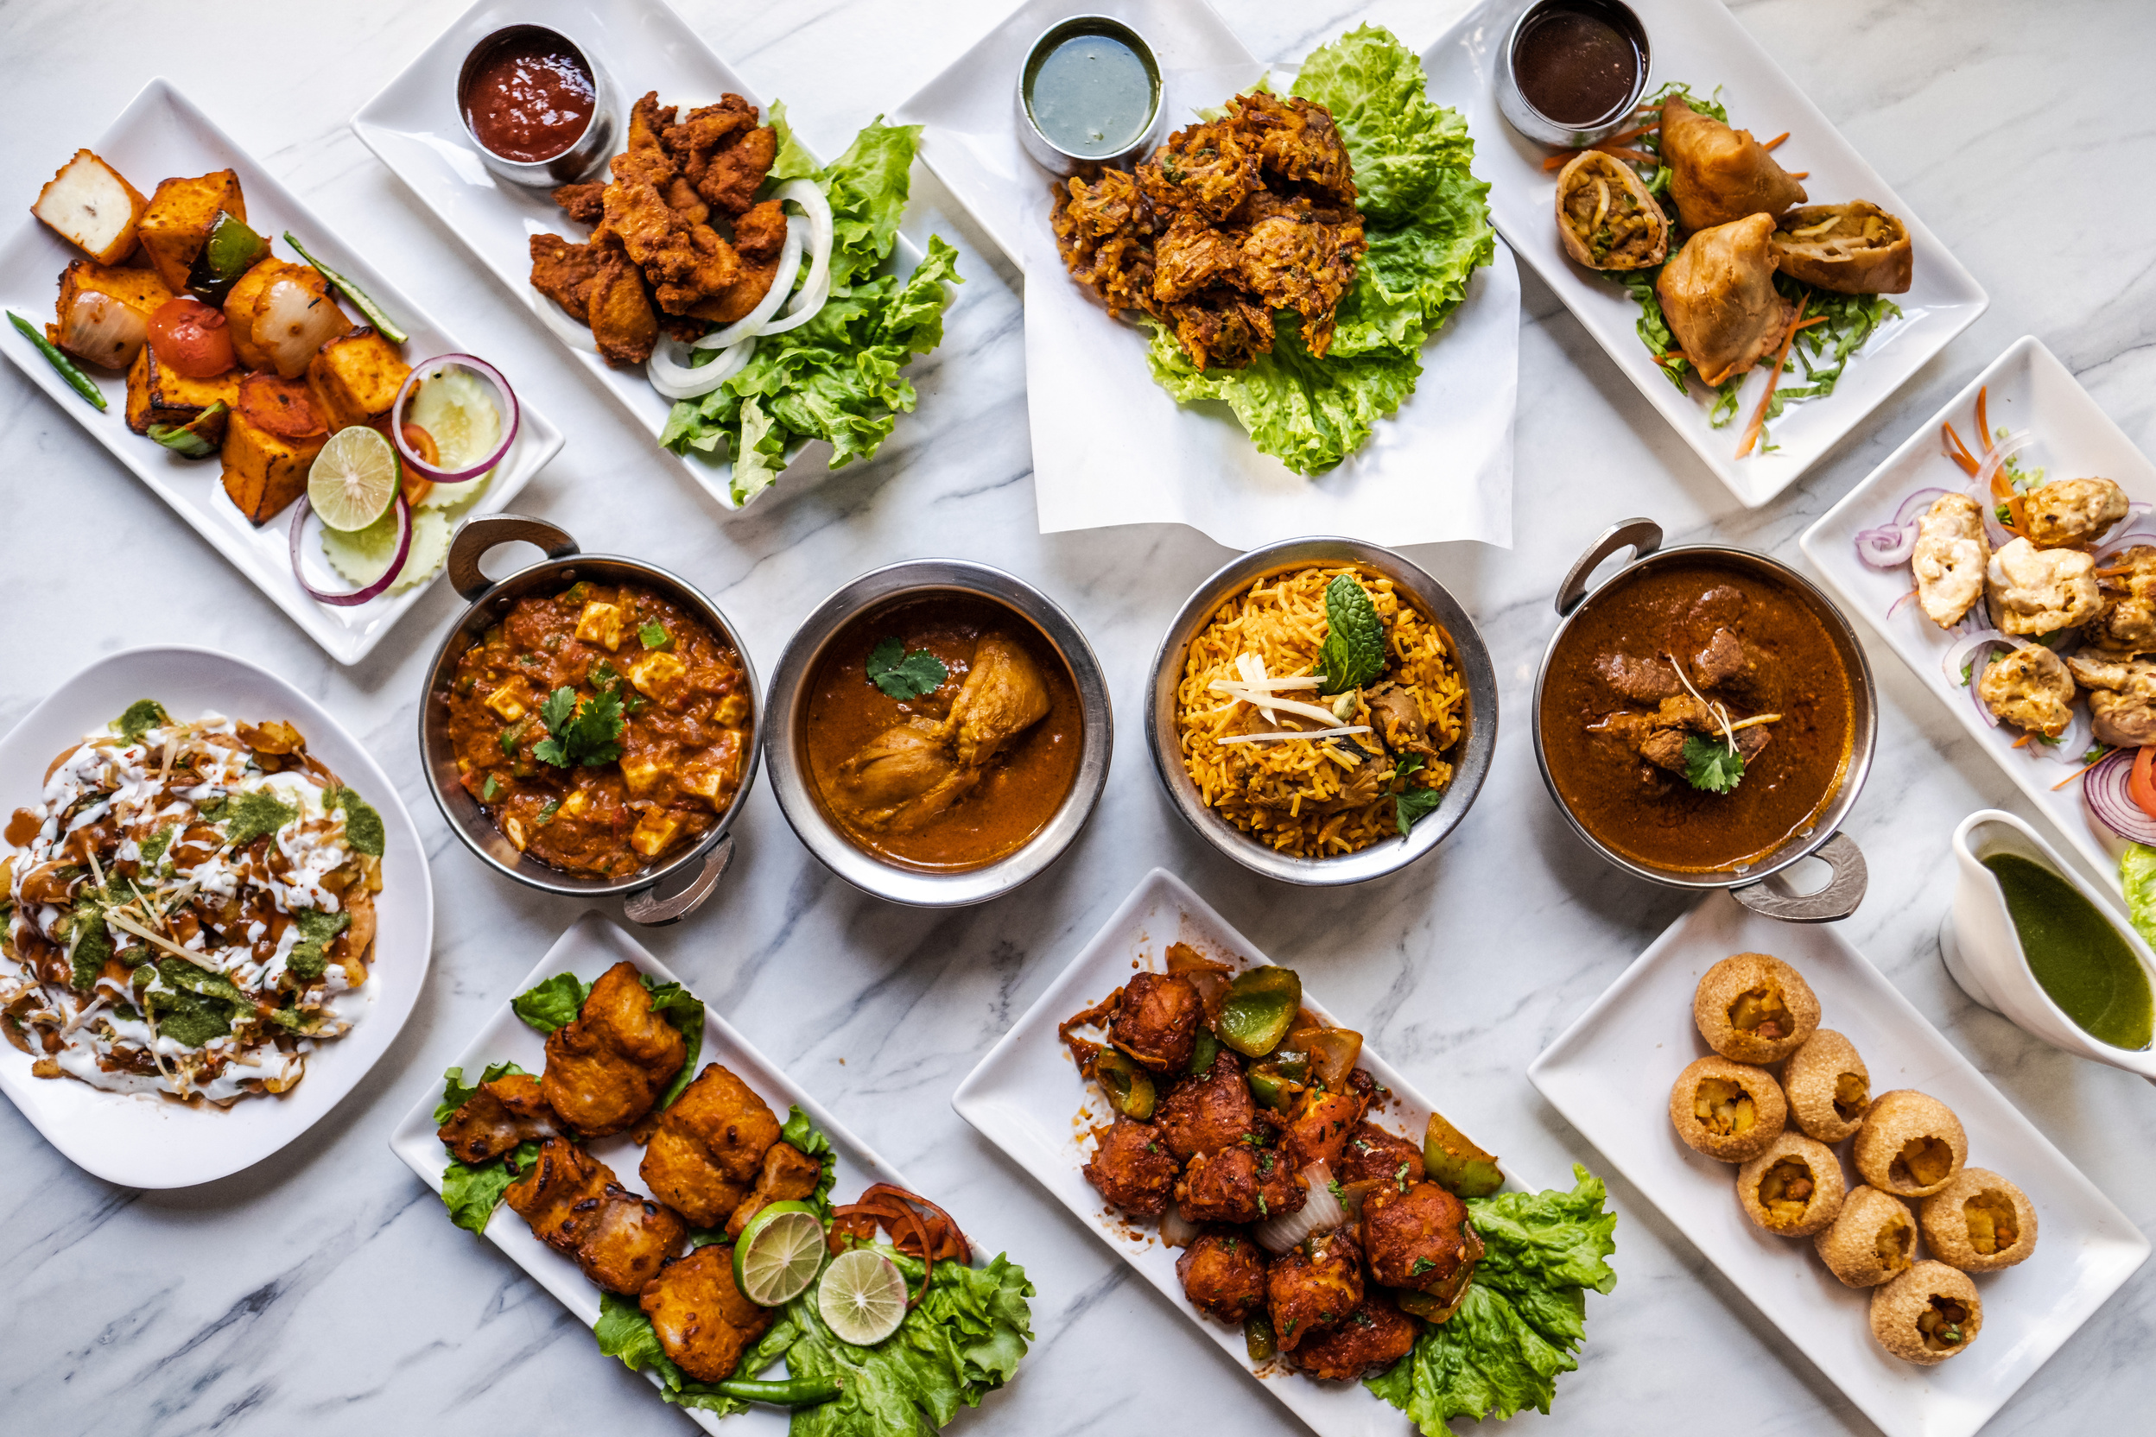



Quality Requirements
QR1
QR2
QR3
QR4
Data Security
Cultural and Law Compliances
Performance
Sustainability

Slide 6

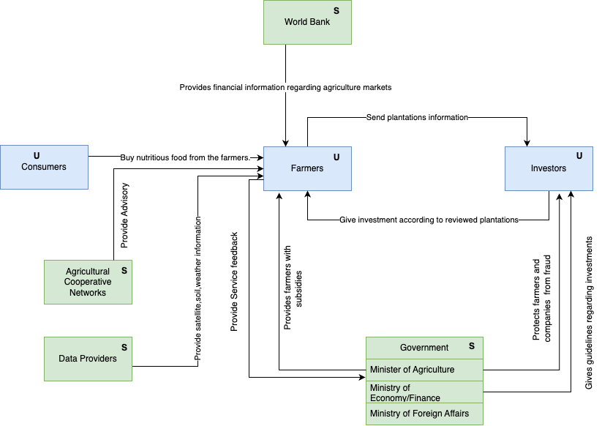
Business Domain Model

Slide 7
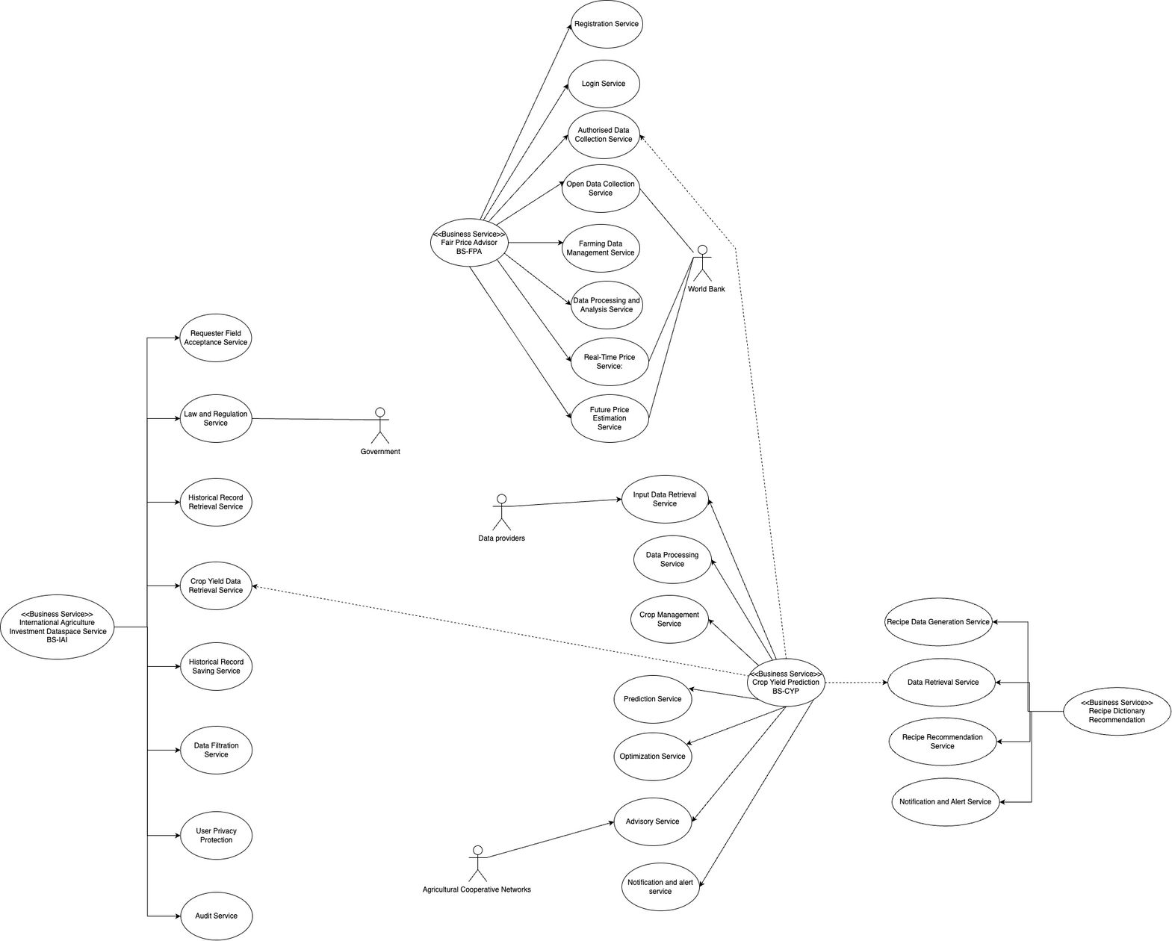
Context Model Diagram

Slide 8
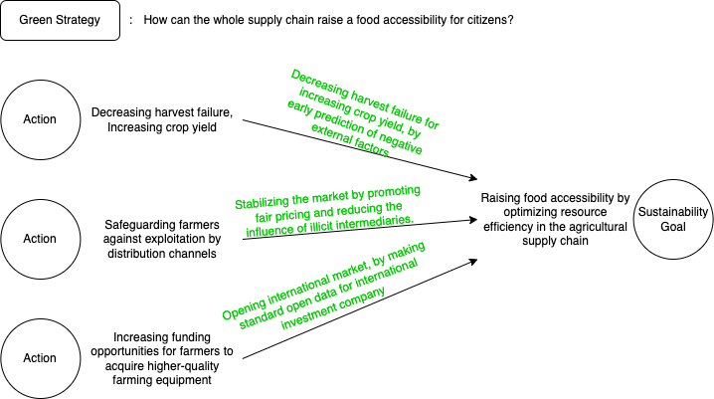



Design Decision Mapping
Social Sustainability

Slide 9
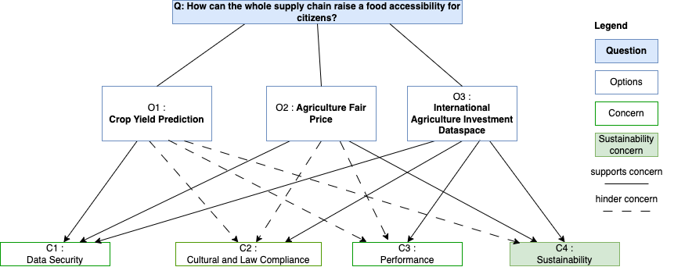

Slide 10
Thank you!

